Slide 1


OCTOBER 2024
COLLEGE TRAINEE
FINAL REPORT
Presented by Tsegaab Nigusse

Slide 2


INTRODUCTION
Trainee Name: Tsegaab Nigusse
Division: College Trainee Engineering
Coach: Getu Zerihun (Eng. IV)
Line Maintenance | Maintenance Control Center | Production Engineering
Duration: April 2024 – October 2024

Slide 3


CONTENTS
01
05
Learning Objectives
Key Accomplishments
02
06
Project Description
Lessons Learned
03
07
Skills & Knowledge Gained
Recommendation
04
08
Challenges Faced
Acknowledgment

Slide 4
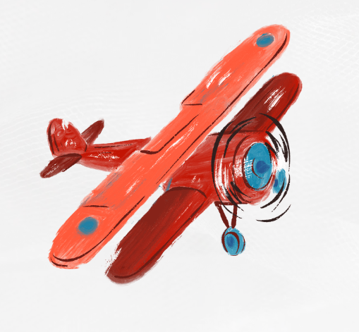
1
Understand Corporate cultures and familiarizing with the working environment.
LEARNING OBJECTIVE
2
Gaining hands-on experience on my working area
3
Enhancing my understanding on various aircraft systems through asking, studying, and training
4
To be aware of safety protocols and to adhere to it everyday
5
To strengthen my communication skill especially in professional way

Slide 5

PROJECT DESCRIPTION
RCCA
MSL and MB
Communication with OEM
prepared several root cause analysis and corrective action & followed the remarks
prepared some maintenance service letters and maintenance bulletins for recommending best practices
Communicated with different manufacturers for tackling various remarks
2
4
1
3
5
Summary Reports
Maintenance Orders
prepared different summary reports mainly related with NGS systems
prepared multiple maintenance orders for resolving different faults

Slide 6




SKILLS KNOWLEDGE GAINED
TECHNICAL
01. OEM Tools
02. Maintenix
03. Reports
04.Company Manuals
IPD, AMM, FIM, WDM
MYBOEINGFLEET
AIRBUSWORLD
DHC
Inventories
Troubleshooting errors
Creating Requirements & job cards
RCCA
MSL
Summary Reports
Maintenance Bulletins
MEL report
Maintenance Program
Aircraft delivery Documents
Minimum Equipment list (MEL)

Slide 7
SKILLS KNOWLEDGE GAINED
SOFT
01. Collaboration
02. Communication
03. Task Management
04.Problem Sloving
working with my colleagues towards a common goal
Conveying technical details professionally
Learning to prioritize task and manage multiple activities effectively
Giving innovative solutions for different challenges

Slide 8


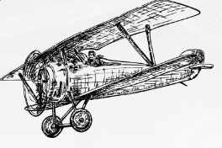
CHALLENGES FACED
ADAPTING TO NEW WORK ENVIRONMENT
ACTIVELY ENGAGE WITH MY CO-WORKERS
BALANCING MULTIPLE TASKS
UTILIZING TASK MANAGEMAENT TOOLS
LEARNING TO USE NEW TOOLS AND SYSTEMS
SEEKING GUIDANCE FROM MY SENIORS

Slide 9
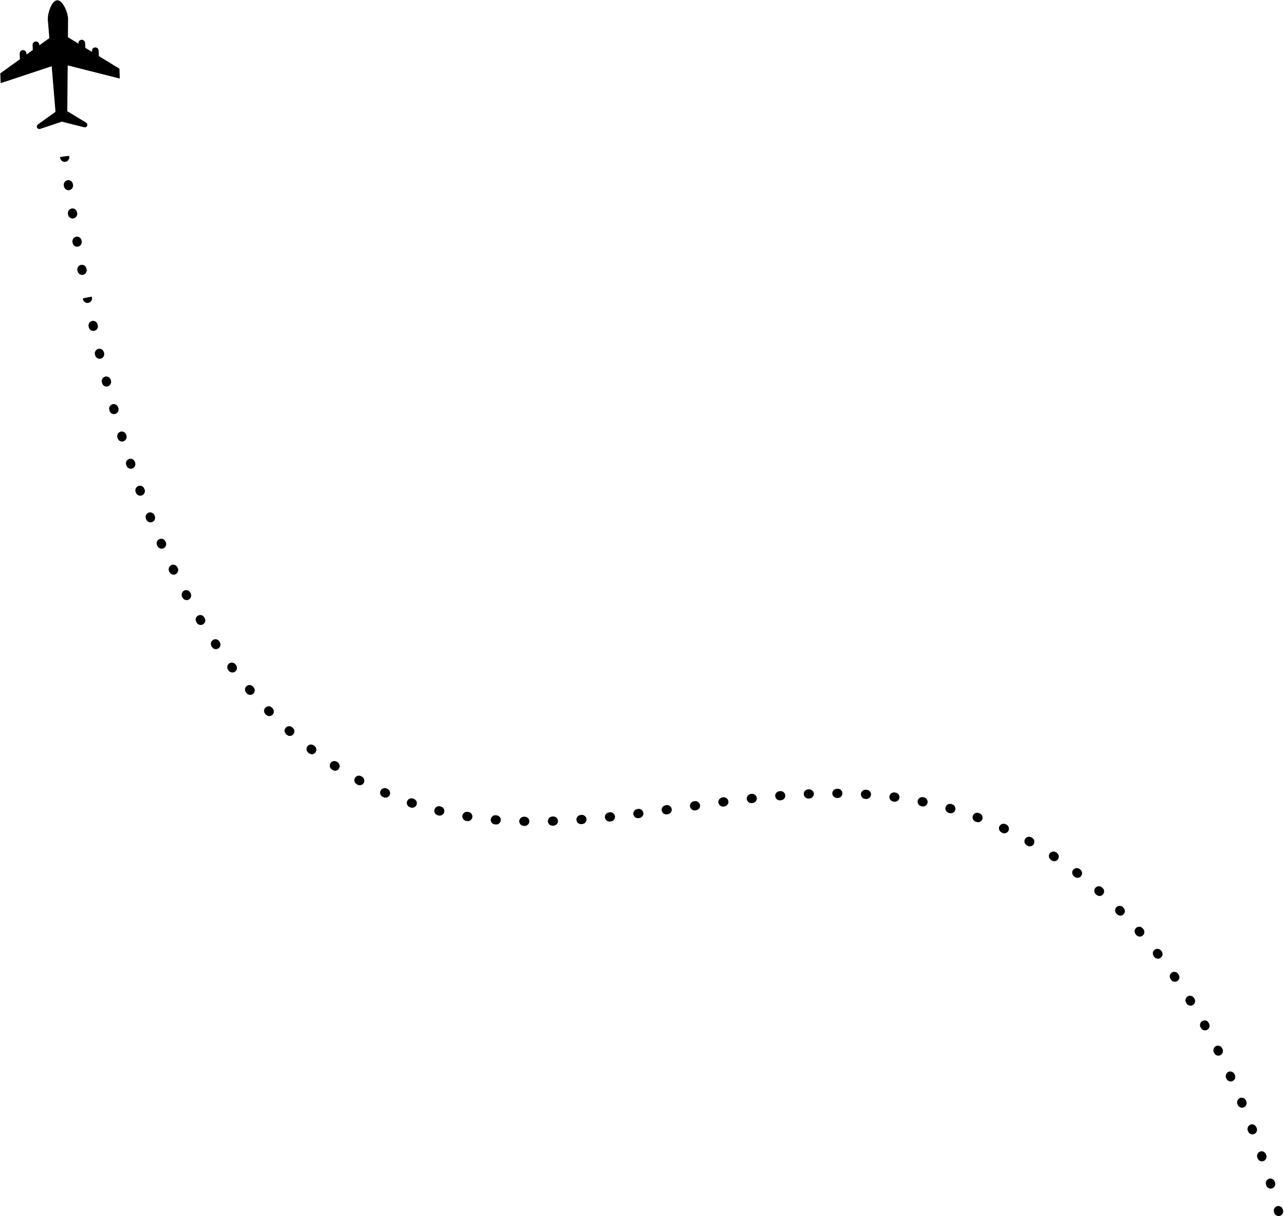





KEY ACCOMPLISHMENTS
01. Web Application
03. RCCA Study
Together with my collegue, we developed a web applicationn for preparing MEL report
Studied different remarks for finding their cause and correct the from happening in future time
02. Summary Reports
04. Maintenance Orders
Worked on different aircraft to maintain their airworthiness.
Helped troubleshooting different fault by preparing maintenance orders

Slide 10


LESSONS LEARNED
Recognizing problems as oportunities to improve workflows
Critical importance of following safty procedures
The importance of seeking guidance from senior, always asking
Benefit of taking notes durring communication
Time managemaent and task prioritizing
The value of effective communication

Slide 11

RECOMMONDATIONS
I recommend allotting at least one-to-two months for trainees to work alongside technicians before starting the On-the-Job Training (OJT)
Providing trainees with learning materials such as computer-based training
(CBT) modules and simulations would be highly beneficial.

Slide 12


ACKNOWLEDGEMENT
MCC TEAMS
Aviation Unversity
I would like to extend my sincere gratitude to our team leader, Tewodros Ambaye, my coach, Getu Zerihun, and my seniors, Abel Admasu, Habtamu Berhanu,and Tewodros Gezu, as well as the entire MCC team for their invaluable guidance and support throughout the program. Their mentorship played a crucial role in helping me navigate my training and achieve success during my OJT at Ethiopian Airlines.
I would like to thank my instructors at Aviation University for familiarizing me with the company's history, culture, and rules, which laid the groundwork for my professional growth during this program.

Slide 13





When everything seems to be going against you, remember that aircraft take off against the wind, not with it.

